Slide 1
Section 1.3 Graphing Absolute Value Equations and Solving Equations with Two Absolute Values

Slide 2
I) Graphing Absolute Value Functions
When graphing the absolute value of a function, any point with a negative y-coordinate will be positive
If the point already had a positive y-coordinate, it will stay positive
Only the Y-coordinate changes, BUT the x-coordinate stays the same
Therefore, any part of the original graph that is under the X-axis will be reflected over(above) the X-axis
© Copyright all rights reserved to Homework depot: www.BCMath.ca

Slide 3
II) Graphs of Absolute Value Functions
The ABS function will reflect any part of the function under the x-axis to above the x-axis
The ABS of a straight line is a V-shape
y
5
The center of the graph is at the x-intercept at X=2
4
3
When writing in PIECE-Wise form, split the domain using the X-intercept
2
1
x
Writing the equation in PIECE-Wise Form:
-4
-3
-2
-1
0
1
2
3
4
5
6
7
-1
-2
Since the right side was reflected, place the negative sign in front of the equation for the to the right side of the domain in your piece wise function
-3
-4
-5

Slide 4
III) How to write the Piece Wise Function:
Steps to find Piece Wise Function for Parabola:
1st Find the X-intercepts of the parabola – Use these x-intercepts to separate the domain as (Left, Middle, Right)
This is the most difficult part, make y=0, and then solve for the “x” value
2nd Write the equation inside the absolute value to the left of each domain, don’t write the absolute value sign!!
3rd Graph the parabola and indicate which parts of the parabola was flipped upside down (left/middle/right)
4th the part that was flipped upside down, place a negative sign in front of the entire equation with brackets around it
NOTE: There are NO absolute signs in a piece wise function!! The whole point is to write it as a piece wise function without the ABSOLUTE value sign!!

Slide 5
Which of the following is the correct piece wise function?

Slide 6
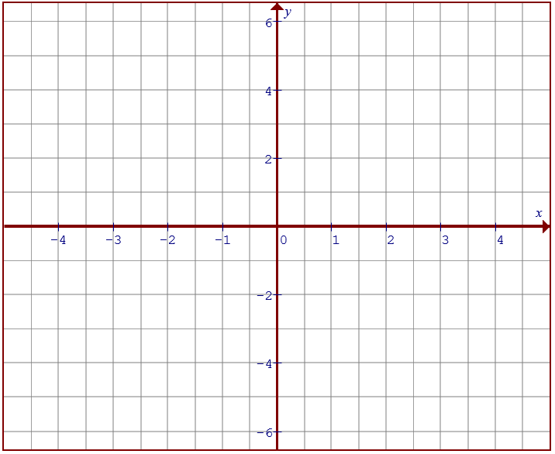
IV) Graphing the ABS Value of a Quadratic Function
When graphing the abs value of a parabola, take any part of the parabola that is under the x-axis, reflect it over/above the x-axis
Step 1 – Find the X-intercepts, use the x-intercepts to split the graph into three separate domains
Step 2- Determine which parts of the graph to reflect upside down (left/middle/right)

Slide 7
Graph the equation and state the piece wise function:
Graph the parabola:
Find the X-intercepts
Take the ABS of the graph, reflecting the middle part that is under the x-axis to ABOVE the x-axis
X: Intercept:
Y: Intercept:
y
Domain:
Range:
5
4
3
2
1
x
-4
-3
-2
-1
0
1
2
3
4
5
6
7
-1
Since the middle domain was reflected, the negative sign is placed in front of the equation
-2
-3
-4
-5

Slide 8
Given the equation:
Which of the following is the correct piece wise function?

Slide 9
Ex: Indicate if there are any Extraneous roots

Slide 10
Solving Equations with Multiple Absolute Values
When solving an equation with ABS value, the coefficient can be positive or negative, resulting with 2 cases
When solving an equation with 2 ABS values, you will then have four cases
Case 1
Case 2
Case 3
Case 4
Solve each case separately and remember to check for extraneous roots

Slide 11
Since there are two absolute values, we need to consider all four cases with each abs value being positive or negative
For cases with solutions, check them by plugging it back in to the original equation
Case 1
Case 4
Case 2
Case 3
Case 4
No Solutions
Solution is good!
Solution is good!
No Solutions

Slide 12
Solve by Graphing:
Move one of the absolute to the right side and create two different absolute graphs
y
5
4
3
2
Since there are TWO intersection points, we have two solutions. The x-coordinates are the solutions
1
x
-4
-3
-2
-1
0
1
2
3
4
5
6
7
-1
-2
-3
-4
-5

Slide 13
Since there are two absolute values, we need to consider all four cases with each abs being positive or negative
Check each solution by plugging it back in
Therefore, the solutions to the system will be x = 2 and x = -1.333
Case 1
Case 2
Case 3
Case 4
Solution!
Extraneous
Extraneous
Solution!

Slide 14
Solve for Graphing:
y
5
4
3
2
1
x
-4
-3
-2
-1
0
1
2
3
4
5
6
7
-1
-2
-3
-4
-5

Slide 15
Check each value of “x” by plugging it back into the equation
The solution to this equation is:
x=2.75 and x= –1.5

Slide 16
Solve for Graphing:
y
5
4
3
2
1
x
-4
-3
-2
-1
0
1
2
3
4
5
6
7
-1
-2
-3
-4
-5

Slide 17
Ex: Solve

